Slide 1
ALGEBRA 4
Day 53

Slide 2
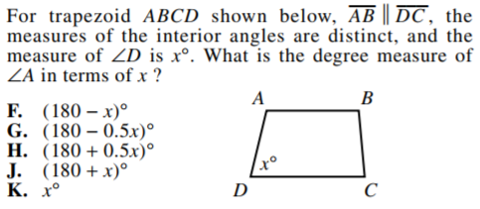
Bell Work

Slide 3
Go over Test

Slide 4
11.1 Permutations and Combinations
Objective: To count permutations and combinations

Slide 5
Scenario: You go to a deli. There are 4 types of meat (Turkey, Ham, Roast Beef, and Pastrami) and 3 types of bread (White, Wheat, and Rye). How many different sandwich combinations do you have to choose from?

Slide 6
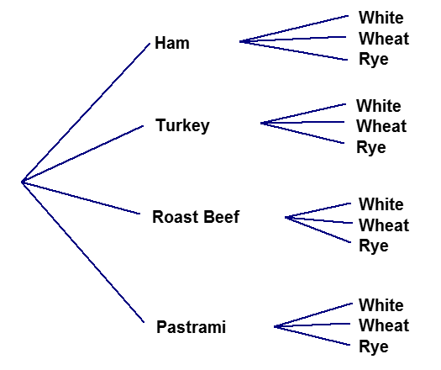
Method 1, Tree Diagram: charting every possible combination of multiple sets of data as a web Count the number of options on the final column (12 combination)

Slide 7
Method 2, Fundamental Counting Principle;
Two Events: If one event can occur in m ways and another event can occur in n ways, then the number of ways that both events can occur is m*n
Example: 4 meat choices, 3 bread choices; (4)(3)=12 combinations

Slide 8
Which method would be better if we added…
5 Cheeses
8 Vegetables
6 Dressings
Etc…
How would this change the outcome if we could select more than one of each item?

Slide 9
The standard configuration for a New York license plate is 3 digits followed by 3 letters.
1) How many different license plates are possible if digits and letters can be repeated?
2) How many different license plates are possible if digits and letters cannot be repeated?

Slide 10
The standard configuration for a New York license plate is 3 digits followed by 3 letters.
1) How many different license plates are possible if digits and letters can be repeated?
(10)(10)(10)(26)(26)(26) = _________
2) How many different license plates are possible if digits and letters cannot be repeated?
(10)(9)(8)(26)(25)(24) = _________

Slide 11

Factorial: the product of all integers from 1 to n denoted by ! (ex: 3! = 3*2*1 = 6)
Examples: Evaluate the factorial:
4! 6! 0!
3! x 4! 1! $\frac{8!}{5!}$

Slide 12
Permutation: an ordering of n objects (Each different order is a new permutation)
Example: How many permutations are there for the letters A, B, and C?

Slide 13
Number of Permutations of n Distinct Objects; n! = n*(n – 1)*(n – 2)*…*3*2*1
Example: Twelve skiers are competing in the final round of the Olympic freestyle skiing aerial competition
a) In how many different ways can the skiers finish the competition?
b) In how many different ways can 3 of the skiers finish first, second, and third to win gold, silver, and bronze?

Slide 14
Permutations of n Objects Taken r at a Time; The number of permutations of r objects taken from a group of n distinct objects is denoted by _{n}P_{r} and is given by:
Note: n is the total number of objects, and r is the number of objects selected from the total

Slide 15
Examples
Find the number of permutations:
₁₀P₆ ₅P₁

Slide 16
Permutations with Repetition; The number of distinguishable permutations of n objects where one object is repeated q₁ times, another is repeated q₂ times, and so on is:

Slide 17
Example:
Find the number of distinguishable permutations of the letters in the word.
a) PENCIL b) LETTER

Slide 18
Combination: a selection of r objects from a group of n objects where the order is not important (ex: hand of cards)
Combinations of n Objects Taken r at a Time;
The number of combinations of r objects taken from a group of n distinct objects is denoted by _{n}C_{r} and is given by:
Note: n is the total number of objects, and r is the number of objects selected from the total

Slide 19
Example
Find the number of combinations:
₁₀C₆ ₅C₁

Slide 20
Permutation or Combination?
Example: You are considering 10 different colleges. Before you decide to apply to the colleges, you want to visit some of them. In how many ways can you visit,
6 of the colleges? 4 of the colleges?

Slide 21
Multiple Events: Event A and Event B → Multiply Event A or Event B → Add

Slide 22
Example: A restaurant serves omelets that can be ordered with any of the ingredients shown.
Vegetarian Meat
Green Pepper Ham
Red Pepper Bacon
Onion Sausage
Mushroom Steak
Tomato
Cheese

Slide 23
a) Suppose you want exactly 2 vegetarian ingredients and 1 meat ingredient in your omelet. How many different types of omelets can you order?
b) Suppose you can afford at most 3 ingredients in your omelet. How many different omelets can you order?

Slide 24
For Next Time
Page 678 #1-6, 9-11, 13-19 (odd), 20, 21-37 (odd), 38-41

